Slide 1
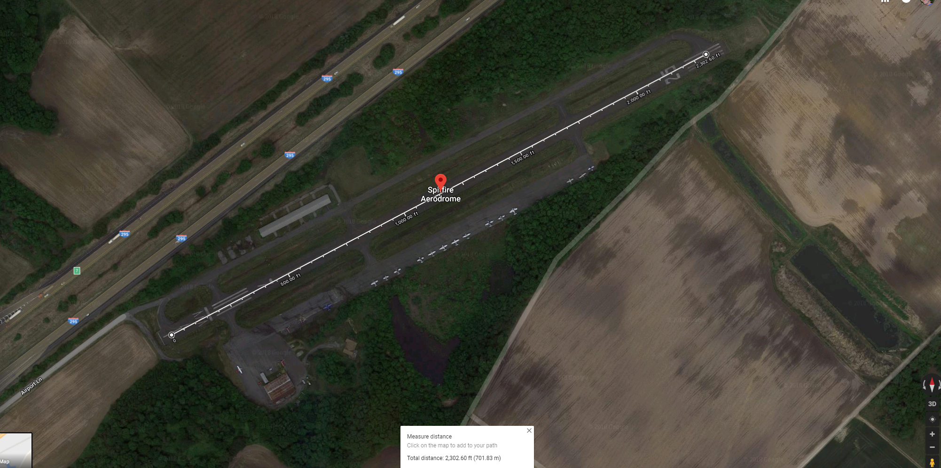
UMAR Status Call 24 May 2018
Outdoor Motor Testing over 1000 hours
Speed test successful. Data reduction underway.

Slide 2
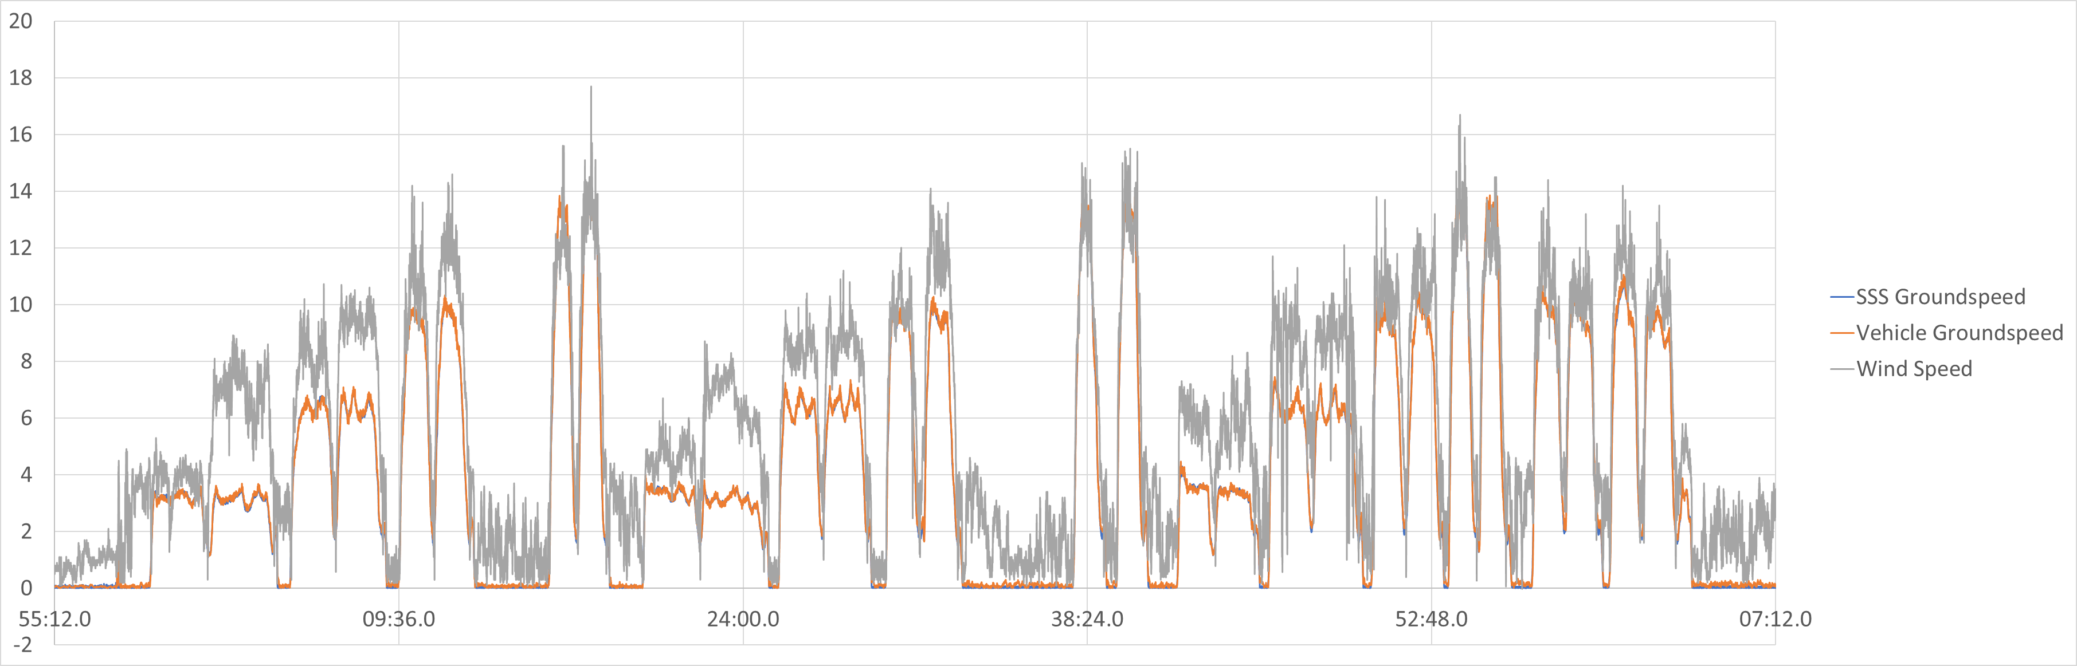
Quick Look
Spitfire Aerodrome Speed Tests on Prototype UMAR at 200, 300, 400 ft.
4 speed set points. Roughly 6,12,18,25 knots
70 minutes in flight to fill out 12 point matrix with East/West Lap

